Slide 1
DATA 606 PRESENTATION
Jeyaraman Ramalingam

Slide 2
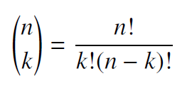
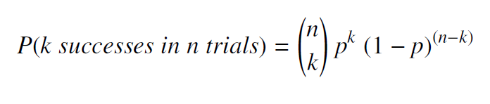
Binomial Distribution
Probability of given number of successes in a given number of trials
# of scenarios * P(Single Scenario)
Difficulty in calculating number of scenarios if the combinations are too many
Choose function is used for finding number of ways to choose
Binomial Probability

Slide 3
Problem 1
Serving in volleyball. (4.30, p. 162) A not-so-skilled volleyball player has a 15% chance of making the serve, which involves hitting the ball so it passes over the net on a trajectory such that it will land in the opposing team’s court. Suppose that her serves are independent of each other.
What is the probability that on the 10th try she will make her 3rd successful serve?
Rpubs link : http://rpubs.com/jey1987/532394
RMD Link : https://github.com/jey1987/DATA606/blob/master/Week4/606_Jeyaraman_Ramalingam_Week4_Homework.Rmd

Slide 4
Problem 2
(b) Suppose she has made two successful serves in nine attempts. What is the probability that her 10th serve will be successful?
The Probability is always 0.15 for nth Serve.

Slide 5
Problem 3
Even though parts (a) and (b) discuss the same scenario, the probabilities you calculated should be different. Can you explain the reason for this discrepancy?
The Problem (a) has one more factor i.e. to calculate 3rd Successful serve and the Problem (b) is just the probability for successful 10th serve

